Slide 1
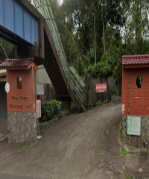
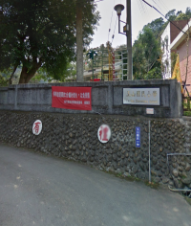
Hsinchu County Guanxi Township 【Xinfu Vil.】 Evacuation Map | NO.10004040010
關西鎮新富里
Disaster Prevention Information
Administration Zone
POP : 573
Dong Guang Elementary School
Emergency Notification
Hsinchu County EOC Tel：03-5529222 Guanxi Township EOC Tel：03-5870110 Guanxi Fire Station Tel：03-5870110 Guanxi Police Station Tel：03-5872007
Emergency Contact
Village Chief ：Mr. Fan Tel：03-5869003 0917-533503
Xinfu vil.
Disaster Information Website
Debris Flow Disaster Prevention Information
Central Weather Bureau
Hsinchu Fire Bureau
Evacuation Shelter
Dong Guang Elementary School Add：No. 190, Shiliuzhang Tel： 03-5872243
Yusan Elementary School Add：No. 25, Chike Mt. Tel： 03-5476475
Yusan Elementary School
Evacuation Principle | LEGEND | Administrative Boundary | Labelling |  | Facility
Flood：Vertical evacuation or preventive evacuate to shelters Earthquake： After earthquake, evacuate outdoors or head to shelters Debris Flow：Preventive evacuate to shelters |  | Village Boundary Line | Evacuation Route |  | Indoor Evacuation Shelter |  | Medical Facility
 |  | Road | Earthquake Shelter | Tsunami Shelter | Outdoor Evacuation Shelter |  | Fire Department
 |  | County Road | Debris Flow Shelter | Flood Shelter | Helipad | Emergency Operation Center | Police Department
Hsinchu County Gov. May, 2022
Drop
Cover
Hold on

