Slide 1
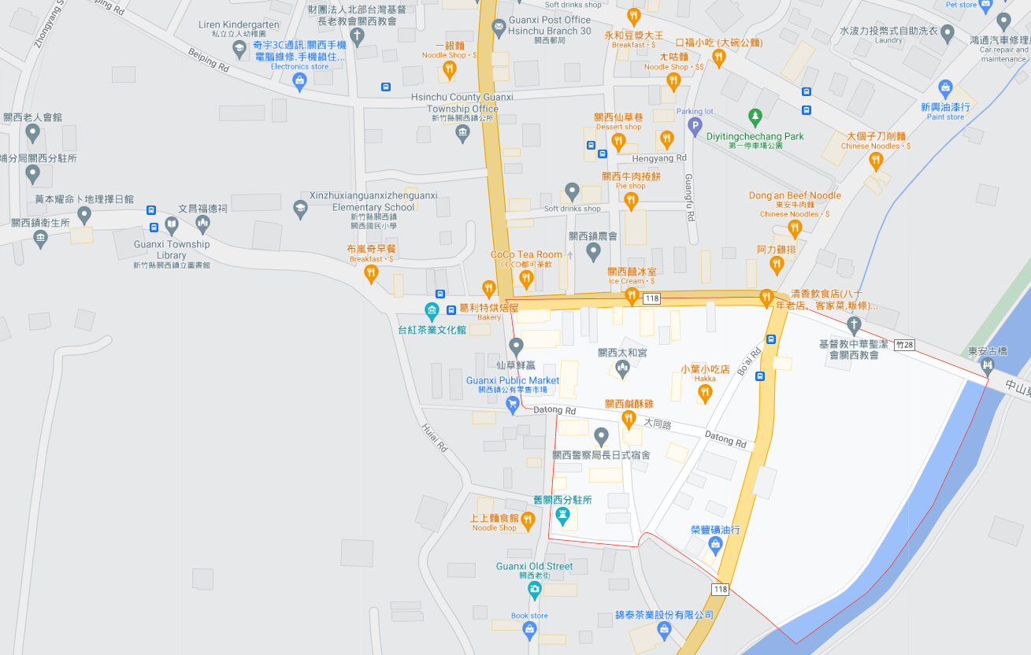
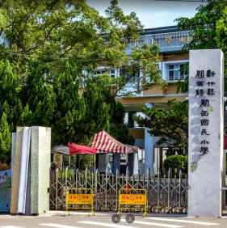
Hsinchu County Guanxi Township 【Dongxing Vil.】 Evacuation Map | NO.10004040001
Disaster Prevention Information
Administration Zone
POP : 552
Guanxi Township Office
Emergency Notification
Hsinchu County EOC Tel：03-5529222 Guanxi Township EOC Tel：03-5870110 Guanxi Fire Station Tel：03-5870110 Guanxi Police Station Tel：03-5872007
Guanxi Police Station
Guans Elementary School
Guanxi Township
Public Health Center
Emergency Contact
Village Chief ：Mr. Peng Tel：03-5875513 0932-763831
Disaster Information Website
Debris Flow Disaster Prevention Information
Central Weather Bureau
Hsinchu Fire Bureau
Dongxing Vil.
Evacuation Shelter
Guans Elementary School Add：No. 126, Zhongshan Rd. Tel： 03-5872008
LEGEND | Administrative Boundary | Labelling |  | Facility
 | Village Boundary Line | Evacuation Route |  | Indoor Evacuation Shelter | Medical Facility | Emergency Operation Center
 | Road | Tsunami Shelter | Earthquake Shelter | Outdoor Evacuation Shelter | Fire Department
 | County Road | Debris Flow Shelter | Flood Shelter | Helipad | Police Department
Hsinchu County Gov. Aug, 2023

Slide 2
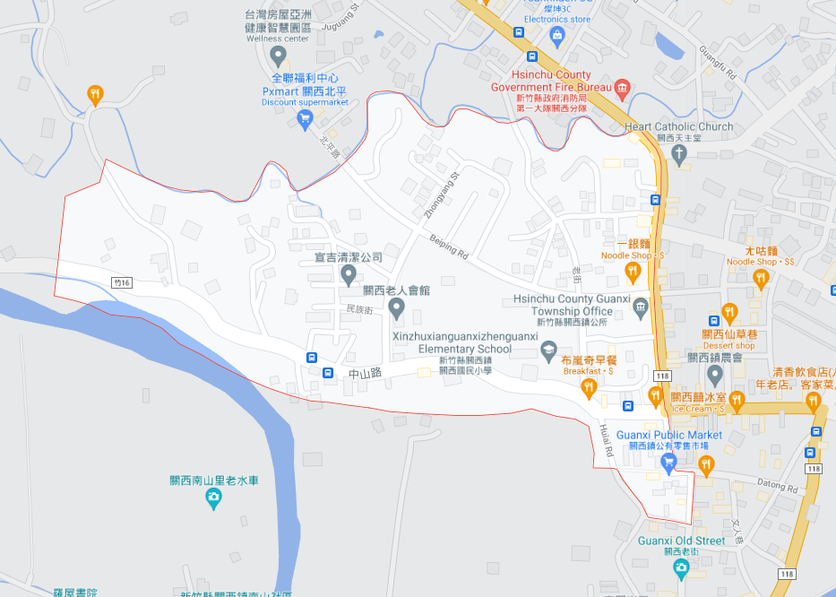
Hsinchu County Guanxi Township 【Xi'an Vil.】 Evacuation Map | NO.10004040002
Disaster Prevention Information
Administration Zone
POP : 2,220
Guanxi Fire Station
Emergency Notification
Hsinchu County EOC Tel：03-5529222 Guanxi Township EOC Tel：03-5870110 Guanxi Fire Station Tel：03-5870110 Guanxi Police Station Tel：03-5872007
Xi'an Vil.
Emergency Contact
Village Chief ：Ms. Lo Tel：03-5877341 0933-793808
Guanxi Township Office
Disaster Information Website
Guanxi Police Station
Guans Elementary School
Debris Flow Disaster Prevention Information
Central Weather Bureau
Guanxi Township
Public Health Center
Hsinchu Fire Bureau
Evacuation Shelter
Guans Elementary School Add：No. 126, Zhongshan Rd. Tel： 03-5872008
LEGEND | Administrative Boundary | Labelling |  | Facility
 | Village Boundary Line | Evacuation Route |  | Indoor Evacuation Shelter | Medical Facility | Emergency Operation Center
 | Road | Tsunami Shelter | Earthquake Shelter | Outdoor Evacuation Shelter | Fire Department
 | County Road | Debris Flow Shelter | Flood Shelter | Helipad | Police Department
Hsinchu County Gov. Aug, 2023

Slide 3
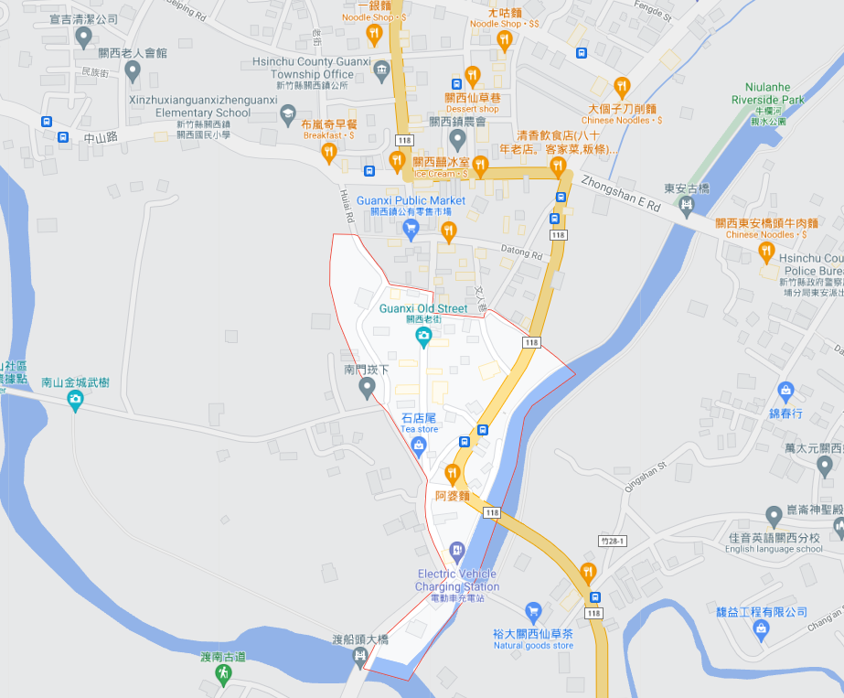
Hsinchu County Guanxi Township 【Nanxiong Vil.】 Evacuation Map | NO.10004040003
Disaster Prevention Information
Administration Zone
POP : 782
Guanxi Township Office
Guanxi Police Station
Guans Elementary School
Emergency Notification
Hsinchu County EOC Tel：03-5529222 Guanxi Township EOC Tel：03-5870110 Guanxi Fire Station Tel：03-5870110 Guanxi Police Station Tel：03-5872007
Guanxi Township
Public Health Center
Emergency Contact
Village Chief ：Ms. Chen Hsieh Tel：03-5876166 0918-213864
Nanxiong Vil.
Disaster Information Website
Debris Flow Disaster Prevention Information
Central Weather Bureau
Hsinchu Fire Bureau
Evacuation Shelter
Guans Elementary School Add：No. 126, Zhongshan Rd. Tel： 03-5872008
LEGEND | Administrative Boundary | Labelling |  | Facility
 | Village Boundary Line | Evacuation Route |  | Indoor Evacuation Shelter | Medical Facility | Emergency Operation Center
 | Road | Tsunami Shelter | Earthquake Shelter | Outdoor Evacuation Shelter | Fire Department
 | County Road | Debris Flow Shelter | Flood Shelter | Helipad | Police Department
Hsinchu County Gov. Aug, 2023

Slide 4
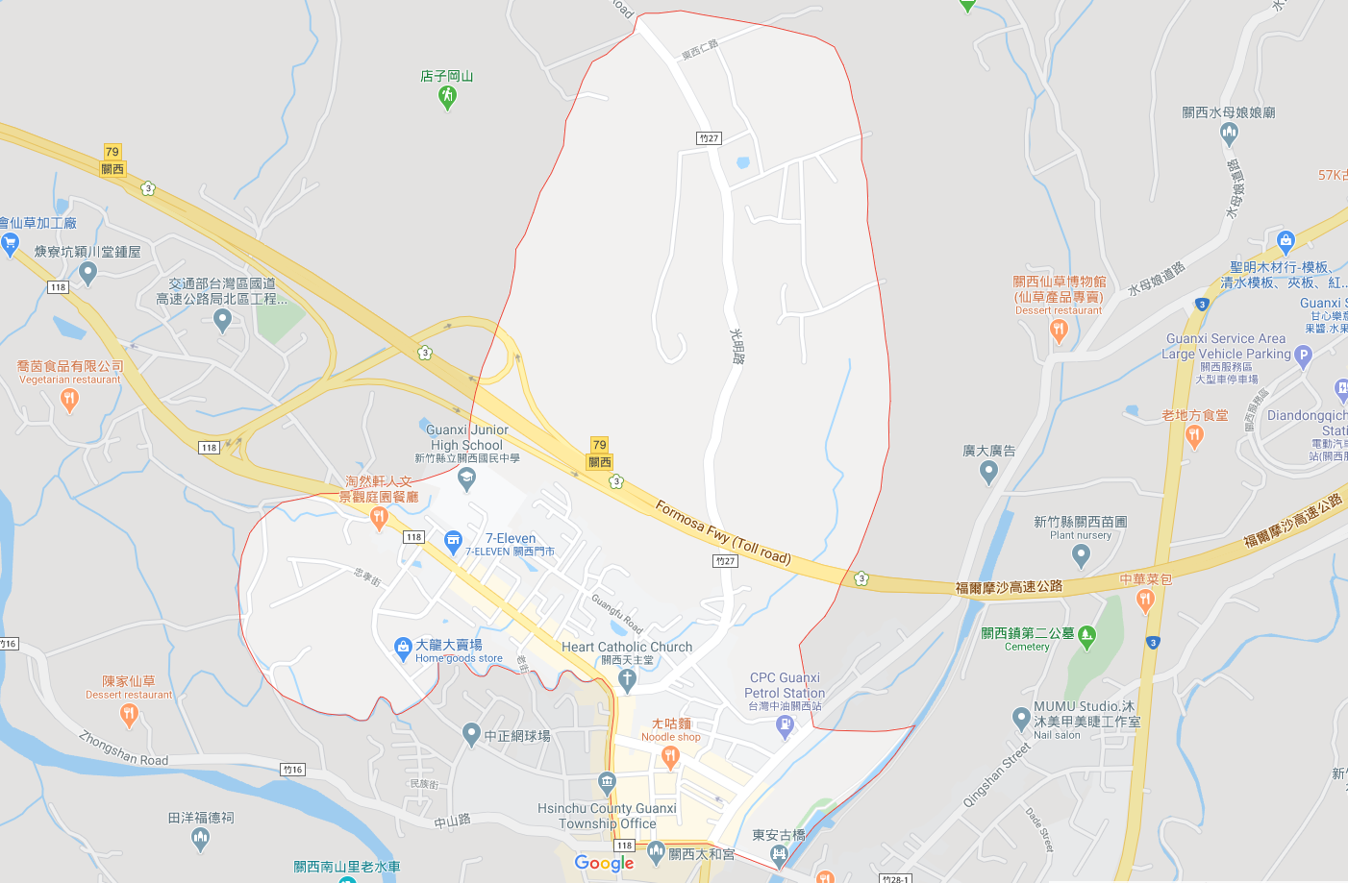
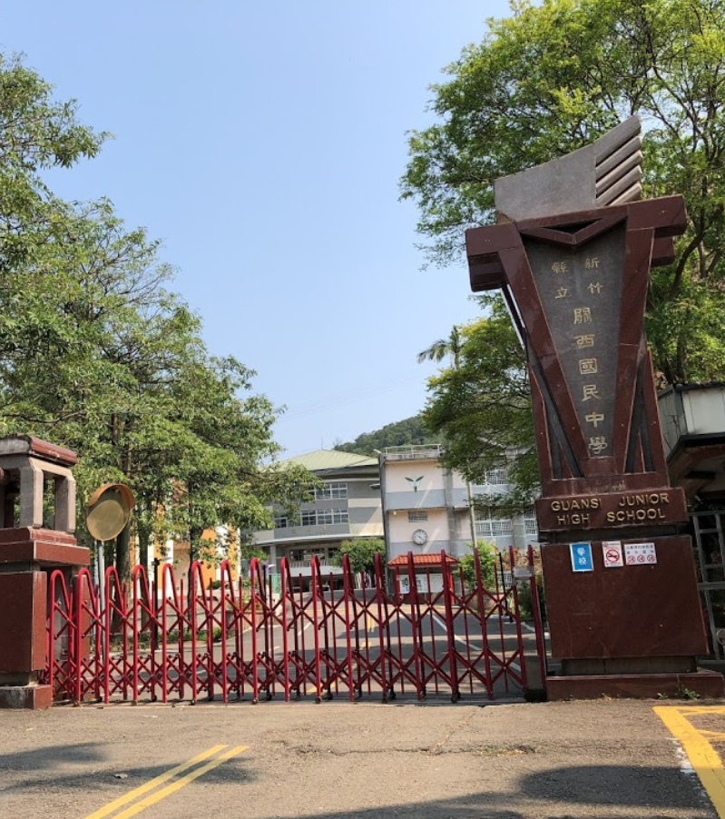
Hsinchu County Guanxi Township 【Beidou Vil.】 Evacuation Map | NO.10004040004
Disaster Prevention Information
Administration Zone
POP : 4,256
Emergency Notification
Hsinchu County EOC Tel：03-5529222 Guanxi Township EOC Tel：03-5870110 Guanxi Fire Station Tel：03-5870110 Guanxi Police Station Tel：03-5872007
Beidou Vil.
Emergency Contact
Village Chief ：Mr. Liu Tel：03-5873251 0932-371868
Guanxi Middle School
Disaster Information Website
Debris Flow Disaster Prevention Information
Central Weather Bureau
Guanxi Fire Station
Hsinchu Fire Bureau
Evacuation Shelter
Guanxi Middle School Add：No. 41, Beimenkou. Tel： 03-5872008
Guanxi Police Station
Guanxi Township Office
Guanxi Township
Public Health Center
LEGEND | Administrative Boundary | Labelling |  | Facility
 | Village Boundary Line | Evacuation Route |  | Indoor Evacuation Shelter | Medical Facility | Emergency Operation Center
 | Road | Tsunami Shelter | Earthquake Shelter | Outdoor Evacuation Shelter | Fire Department
 | County Road | Debris Flow Shelter | Flood Shelter | Helipad | Police Department
Hsinchu County Gov. Aug 2023

Slide 5
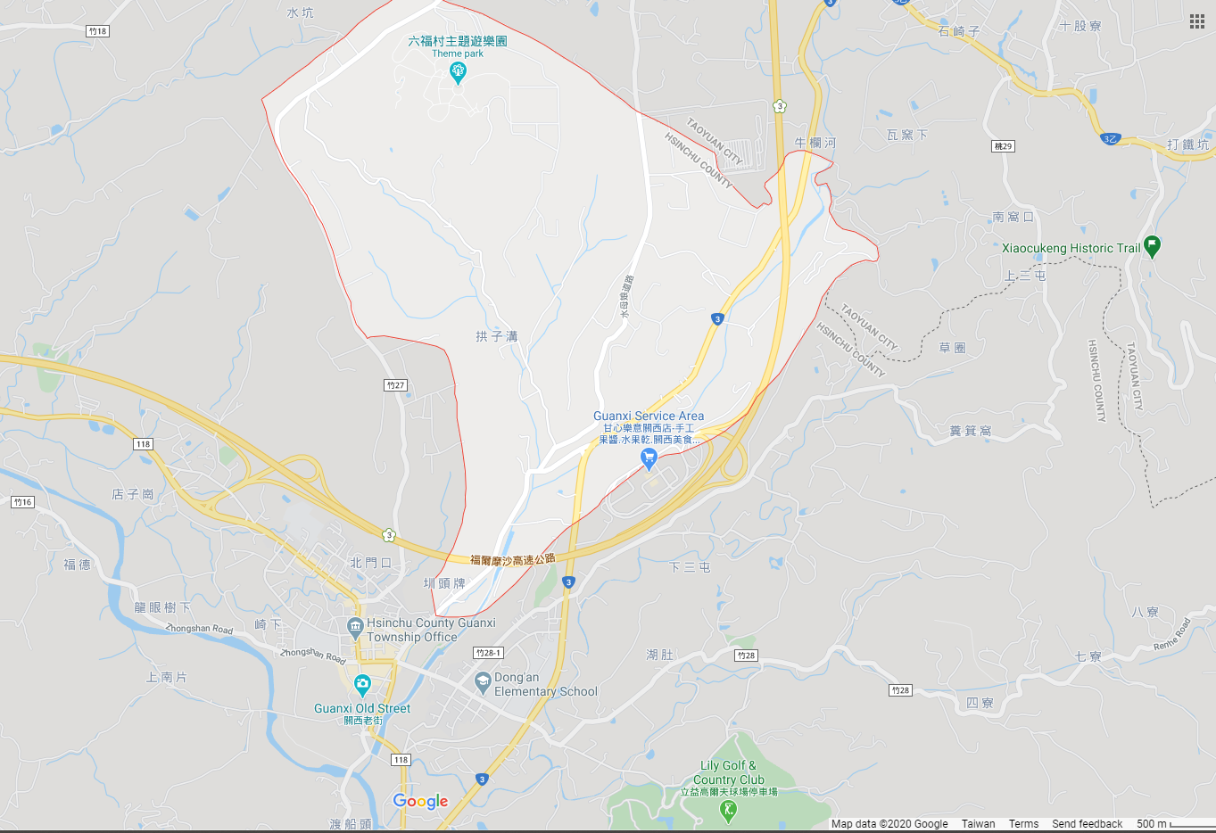
Hsinchu County Guanxi Township 【Ren'an Vil.】 Evacuation Map | NO.10004040005
Disaster Prevention Information
Administration Zone
POP : 1,083
Emergency Notification
Hsinchu County EOC Tel：03-5529222 Guanxi Township EOC Tel：03-5870110 Guanxi Fire Station Tel：03-5870110 Guanxi Police Station Tel：03-5872007
Ren'an Vil.
Emergency Contact
Village Chief ：Ms. Huang Tel：03-5875054 0905-900810
Disaster Information Website
Guanxi Middle School
Debris Flow Disaster Prevention Information
Central Weather Bureau
Hsinchu Fire Bureau
Guanxi Fire Station
Evacuation Shelter
Guanxi Senior High School Add：No. 2, Zhongshan E. Rd. Tel：03-5872049
Guanxi Middle School Add：No. 41, Beimenkou. Tel： 03-5872008
Guanxi Township
Public Health Center
Guanxi Township Office
Guanxi Senior High School
LEGEND | Administrative Boundary | Labelling |  | Facility
 | Village Boundary Line | Evacuation Route |  | Indoor Evacuation Shelter | Medical Facility | Emergency Operation Center
 | Road | Tsunami Shelter | Earthquake Shelter | Outdoor Evacuation Shelter | Fire Department
 | County Road | Debris Flow Shelter | Flood Shelter | Helipad | Police Department
Hsinchu County Gov. Aug, 2023

Slide 6
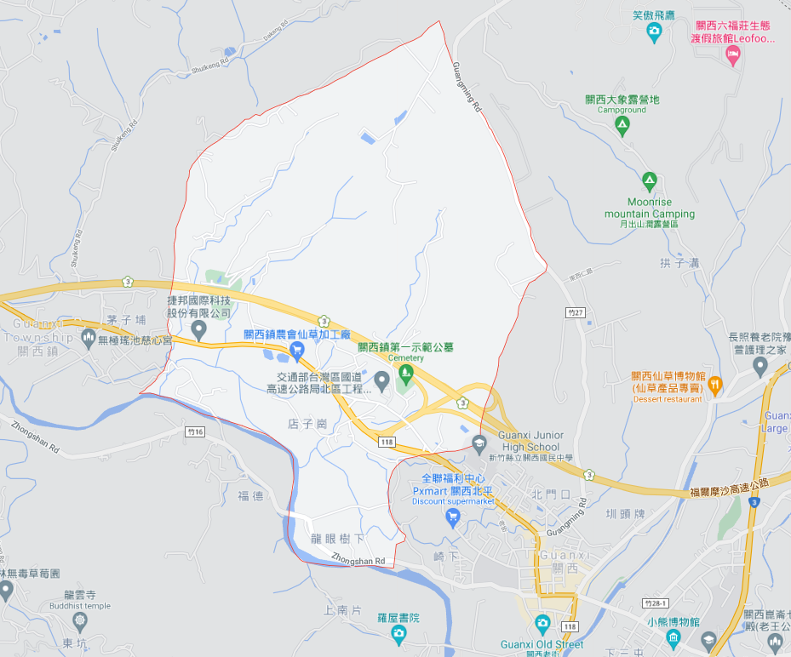
Hsinchu County Guanxi Township 【Beishan Vil.】 Evacuation Map | NO.10004040006
Disaster Prevention Information
Administration Zone
POP : 842
Beishan Vil.
Emergency Notification
Hsinchu County EOC Tel：03-5529222 Guanxi Township EOC Tel：03-5870110 Guanxi Fire Station Tel：03-5870110 Guanxi Police Station Tel：03-5872007
Emergency Contact
Village Chief ：Mr . Chiu Tel：03-5873090 0911-255323
Disaster Information Website
Debris Flow Disaster Prevention Information
Central Weather Bureau
Hsinchu Fire Bureau
Guanxi Middle School
Evacuation Shelter
Guanxi Middle School Add：No. 41, Beimenkou. Tel： 03-5872008
Guanxi Fire Station
Guanxi Police Station
Guanxi Township Office
Guanxi Township
Public Health Center
Dongan Police Station
LEGEND | Administrative Boundary | Labelling |  | Facility
 | Village Boundary Line | Evacuation Route |  | Indoor Evacuation Shelter | Medical Facility | Emergency Operation Center
 | Road | Tsunami Shelter | Earthquake Shelter | Outdoor Evacuation Shelter | Fire Department
 | County Road | Debris Flow Shelter | Flood Shelter | Helipad | Police Department
Hsinchu County Gov. Aug, 2023

Slide 7
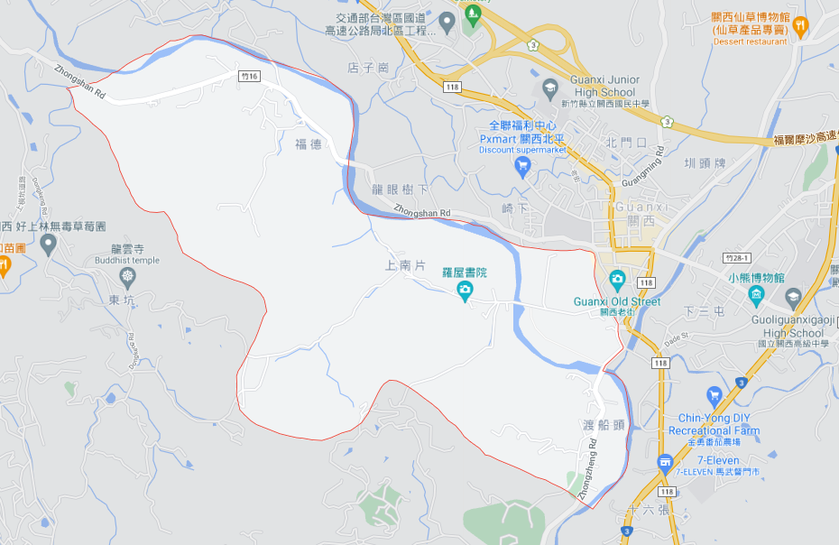
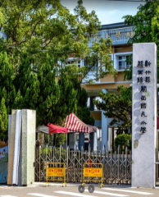
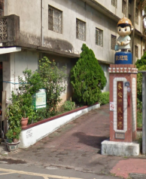
Hsinchu County Guanxi Township 【NanshanVil.】 Evacuation Map | NO.10004040007
Disaster Prevention Information
Administration Zone
POP : 1,192
Nanshan Vil.
Emergency Notification
Hsinchu County EOC Tel：03-5529222 Guanxi Township EOC Tel：03-5870110 Guanxi Fire Station Tel：03-5870110 Guanxi Police Station Tel：03-5872007
Guanxi Fire Station
Guans Elementary School
Guanxi Township Office
Emergency Contact
Village Chief ：Mr. Lo Tel：03-5870069 0932-376692
Guanxi Police Station
Guanxi Township Public Health Center
Disaster Information Website
Dong-an Elementary School
Debris Flow Disaster Prevention Information
Central Weather Bureau
Hsinchu Fire Bureau
Evacuation Shelter
Guans Elementary School Add：No. 126, Zhongshan Rd. Tel： 03-5872008
Dong-an Elementary School Add：No. 40, Zhongshan E. Rd. Tel： 03-5872177
LEGEND | Administrative Boundary | Labelling |  | Facility
 | Village Boundary Line | Evacuation Route |  | Indoor Evacuation Shelter | Medical Facility | Emergency Operation Center
 | Road | Tsunami Shelter | Earthquake Shelter | Outdoor Evacuation Shelter | Fire Department
 | County Road | Debris Flow Shelter | Flood Shelter | Helipad | Police Department
Hsinchu County Gov. Aug, 2023

Slide 8
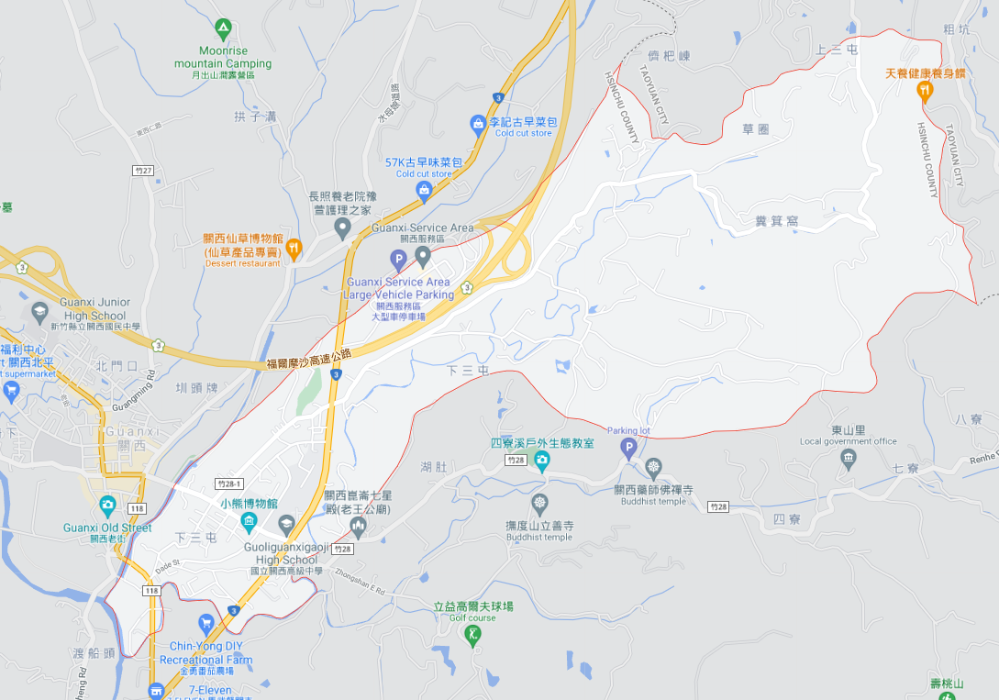
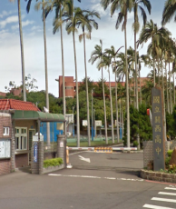
Hsinchu County Guanxi Township 【Dong'an Vil.】 Evacuation Map | NO.10004040008
Disaster Prevention Information
Administration Zone
POP : 4,440
Emergency Notification
Hsinchu County EOC Tel：03-5529222 Guanxi Township EOC Tel：03-5870110 Guanxi Fire Station Tel：03-5870110 Guanxi Police Station Tel：03-5872007
Dong'an Vil.
Emergency Contact
Village Chief ：Mr. Hsieh Tel：03-5873857 0932-277853
Guanxi Fire Station
Disaster Information Website
Debris Flow Disaster Prevention Information
Guanxi Police Station
Guanxi Township Office
Central Weather Bureau
Dongan Police Station
Hsinchu Fire Bureau
Dong-an Elementary School
Guanxi Township
Public Health Center
Guanxi Senior High School
Evacuation Shelter
Dong-an Elementary School Add：No. 40, Zhongshan E. Rd. Tel： 03-5872177
Guanxi Senior High School Add：No. 2, Zhongshan E. Rd. Tel： 03-5872049
LEGEND | Administrative Boundary | Labelling |  | Facility
 | Village Boundary Line | Evacuation Route |  | Indoor Evacuation Shelter | Medical Facility | Emergency Operation Center
 | Road | Tsunami Shelter | Earthquake Shelter | Outdoor Evacuation Shelter | Fire Department
 | County Road | Debris Flow Shelter | Flood Shelter | Helipad | Police Department
Hsinchu County Gov. Aug, 2023

Slide 9
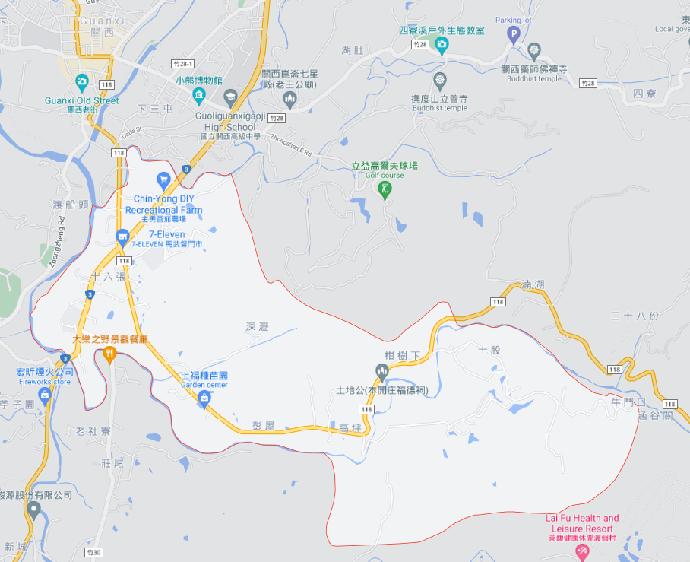
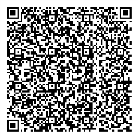
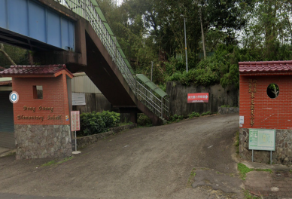
Hsinchu County Guanxi Township 【Dongguang Vil.】 Evacuation Map | NO.10004040009
Disaster Prevention Information
Guanxi Police Station
Administration Zone
POP : 1,369
Guanxi Township Office
Guanxi Township
Public Health Center
Emergency Notification
Hsinchu County EOC Tel：03-5529222 Guanxi Township EOC Tel：03-5870110 Guanxi Fire Station Tel：03-5870110 Guanxi Police Station Tel：03-5872007
Emergency Contact
Village Chief ：Mr. Yeh Tel：03-5873020 0932-378295
Dongguang Elementary School
Disaster Information Website
Debris Flow Disaster Prevention Information
Central Weather Bureau
Hsinchu Fire Bureau
Evacuation Shelter
Dongguang Elementary School Add：No. 190, Shiliuzhang. Tel： 03-5872243
Dongguang Vil.
LEGEND | Administrative Boundary | Labelling |  | Facility
 | Village Boundary Line | Evacuation Route |  | Indoor Evacuation Shelter | Medical Facility | Emergency Operation Center
 | Road | Tsunami Shelter | Earthquake Shelter | Outdoor Evacuation Shelter | Fire Department
 | County Road | Debris Flow Shelter | Flood Shelter | Helipad | Police Department
Hsinchu County Gov. Aug, 2023

Slide 10
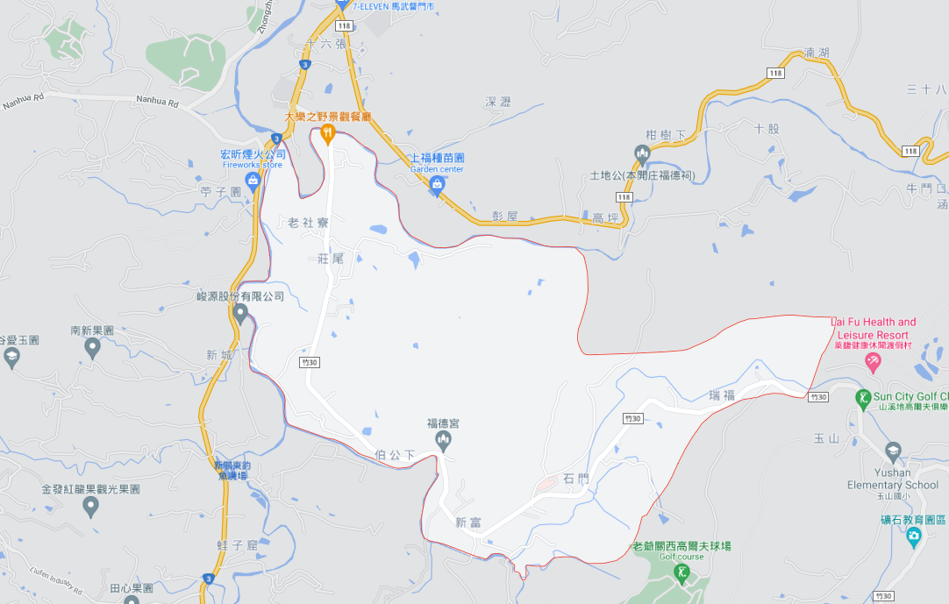
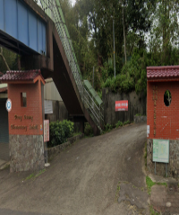
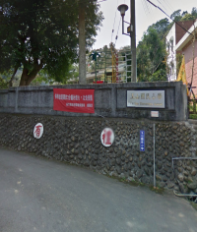
Hsinchu County Guanxi Township 【Xinfu Vil.】 Evacuation Map | NO.10004040010
Disaster Prevention Information
Administration Zone
POP : 573
Dongguang Elementary School
Emergency Notification
Hsinchu County EOC Tel：03-5529222 Guanxi Township EOC Tel：03-5870110 Guanxi Fire Station Tel：03-5870110 Guanxi Police Station Tel：03-5872007
Emergency Contact
Village Chief ：Mr. Fan Tel：03-5869003 0917-533503
Xinfu Vil.
Disaster Information Website
Debris Flow Disaster Prevention Information
Central Weather Bureau
Hsinchu Fire Bureau
Evacuation Shelter
Dongguang Elementary School Add：No. 190, Shiliuzhang. Tel： 03-5872243
Yu Shen Elementary School Add：No. 25, Chike Mt. Tel： 03-5476475
Yu Shen Elementary School
LEGEND | Administrative Boundary | Labelling |  | Facility
 | Village Boundary Line | Evacuation Route |  | Indoor Evacuation Shelter | Medical Facility | Emergency Operation Center
 | Road | Tsunami Shelter | Earthquake Shelter | Outdoor Evacuation Shelter | Fire Department
 | County Road | Debris Flow Shelter | Flood Shelter | Helipad | Police Department
Hsinchu County Gov. Aug, 2023

Slide 11
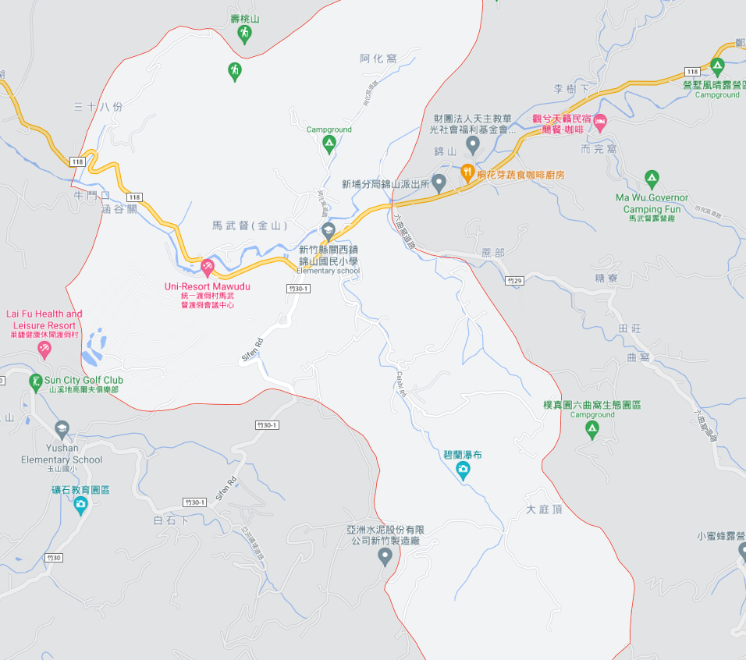
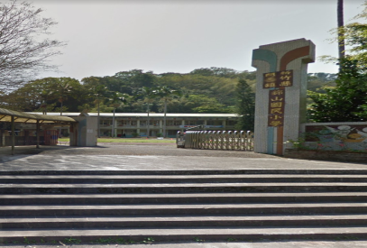
Hsinchu County Guanxi Township 【Jinshan Vil.】 Evacuation Map | NO.10004040011
Disaster Prevention Information
Administration Zone
POP : 575
Jinshan Vil.
Emergency Notification
Hsinchu County EOC Tel：03-5529222 Guanxi Township EOC Tel：03-5870110 Guanxi Fire Station Tel：03-5870110 Guanxi Police Station Tel：03-5872007
Jinshan Police Station
Emergency Contact
Village Chief ：Mr. Lin Tel：03-5478800 0932-096242
Jinshan Elementary School
Disaster Information Website
Debris Flow Disaster Prevention Information
Central Weather Bureau
Hsinchu Fire Bureau
Evacuation Shelter
Jinshan Elementary School Add：No. 107, Mawudu. Tel： 03-5478681
LEGEND | Administrative Boundary | Labelling |  | Facility
 | Village Boundary Line | Evacuation Route |  | Indoor Evacuation Shelter | Medical Facility | Emergency Operation Center
 | Road | Tsunami Shelter | Earthquake Shelter | Outdoor Evacuation Shelter | Fire Department
 | County Road | Debris Flow Shelter | Flood Shelter | Helipad | Police Department
Hsinchu County Gov. Aug, 2023

Slide 12
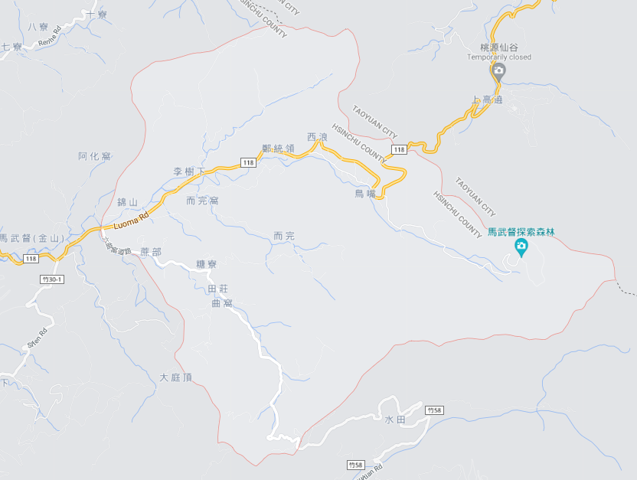
Hsinchu County Guanxi Township 【Jinshan Vil.】 Evacuation Map | NO.10004040012
Disaster Prevention Information
Administration Zone
POP : 998
Jinshan Vil.
Emergency Notification
Hsinchu County EOC Tel：03-5529222 Guanxi Township EOC Tel：03-5870110 Guanxi Fire Station Tel：03-5870110 Guanxi Police Station Tel：03-5872007
Jinshan Police Station
Emergency Contact
Village Chief ：Mr. Lin Tel：03-5478568 0933-260543
Disaster Information Website
Debris Flow Disaster Prevention Information
Jinshan Elementary School
Central Weather Bureau
Hsinchu Fire Bureau
Evacuation Shelter
Jinshan Elementary School Add：No. 107, Mawudu. Tel： 03-5478681
LEGEND | Administrative Boundary | Labelling |  | Facility
 | Village Boundary Line | Evacuation Route |  | Indoor Evacuation Shelter | Medical Facility | Emergency Operation Center
 | Road | Tsunami Shelter | Earthquake Shelter | Outdoor Evacuation Shelter | Fire Department
 | County Road | Debris Flow Shelter | Flood Shelter | Helipad | Police Department
Hsinchu County Gov. Aug, 2023

Slide 13
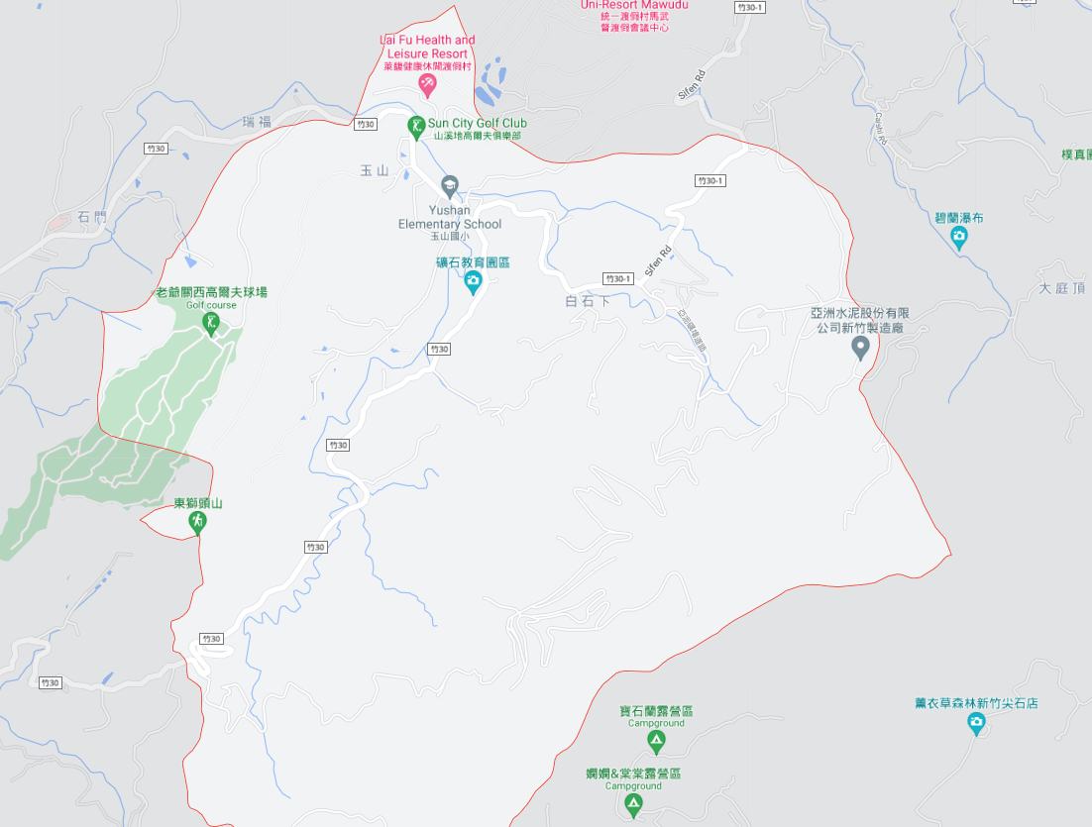
Hsinchu County Guanxi Township 【Yushan Vil.】 Evacuation Map | NO.10004040013
Disaster Prevention Information
Administration Zone
POP : 472
Emergency Notification
Hsinchu County EOC Tel：03-5529222 Guanxi Township EOC Tel：03-5870110 Guanxi Fire Station Tel：03-5870110 Guanxi Police Station Tel：03-5872007
Yu Shen Elementary School
Yushan Vil.
Emergency Contact
Village Chief ：Mr. Chang Tel：03-5476398 0932-173939
Disaster Information Website
Debris Flow Disaster Prevention Information
Central Weather Bureau
Hsinchu Fire Bureau
Evacuation Shelter
Yu Shen Elementary School Add：No. 25, Chike Mt. Tel： 03-5476475
LEGEND | Administrative Boundary | Labelling |  | Facility
 | Village Boundary Line | Evacuation Route |  | Indoor Evacuation Shelter | Medical Facility | Emergency Operation Center
 | Road | Tsunami Shelter | Earthquake Shelter | Outdoor Evacuation Shelter | Fire Department
 | County Road | Debris Flow Shelter | Flood Shelter | Helipad | Police Department
Hsinchu County Gov. Aug, 2023

Slide 14
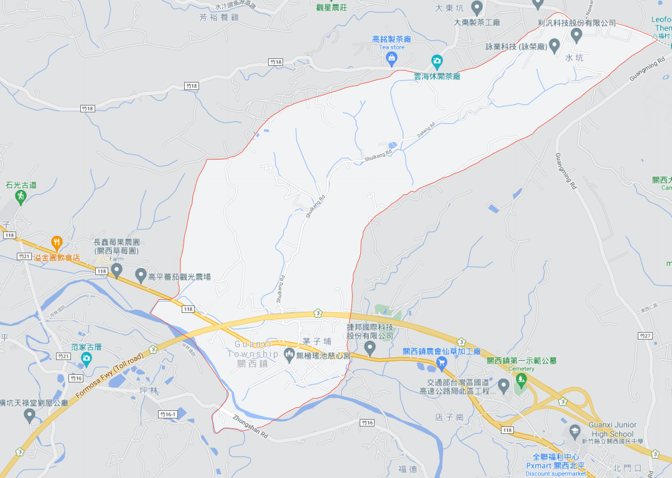
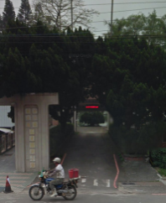
Hsinchu County Guanxi Township 【Datong Vil.】 Evacuation Map | NO.10004040014
Disaster Prevention Information
Administration Zone
POP : 857
Emergency Notification
Hsinchu County EOC Tel：03-5529222 Guanxi Township EOC Tel：03-5870110 Guanxi Fire Station Tel：03-5870110 Guanxi Police Station Tel：03-5872007
Datong Vil.
Emergency Contact
Village Chief ：Mr. Chen Tel：03-5873373 0953-203855
Shiguang Elementary School
Disaster Information Website
Debris Flow Disaster Prevention Information
Central Weather Bureau
Hsinchu Fire Bureau
Evacuation Shelter
Shiguang Elementary School Add：No. 386, Shigangzi. Tel： 03-5869311
Guanxi Middle School Add：No. 41, Beimenkou. Tel： 03-5872008
Guanxi Middle School
LEGEND | Administrative Boundary | Labelling |  | Facility
 | Village Boundary Line | Evacuation Route |  | Indoor Evacuation Shelter | Medical Facility | Emergency Operation Center
 | Road | Tsunami Shelter | Earthquake Shelter | Outdoor Evacuation Shelter | Fire Department
 | County Road | Debris Flow Shelter | Flood Shelter | Helipad | Police Department
Hsinchu County Gov. Aug, 2023

Slide 15
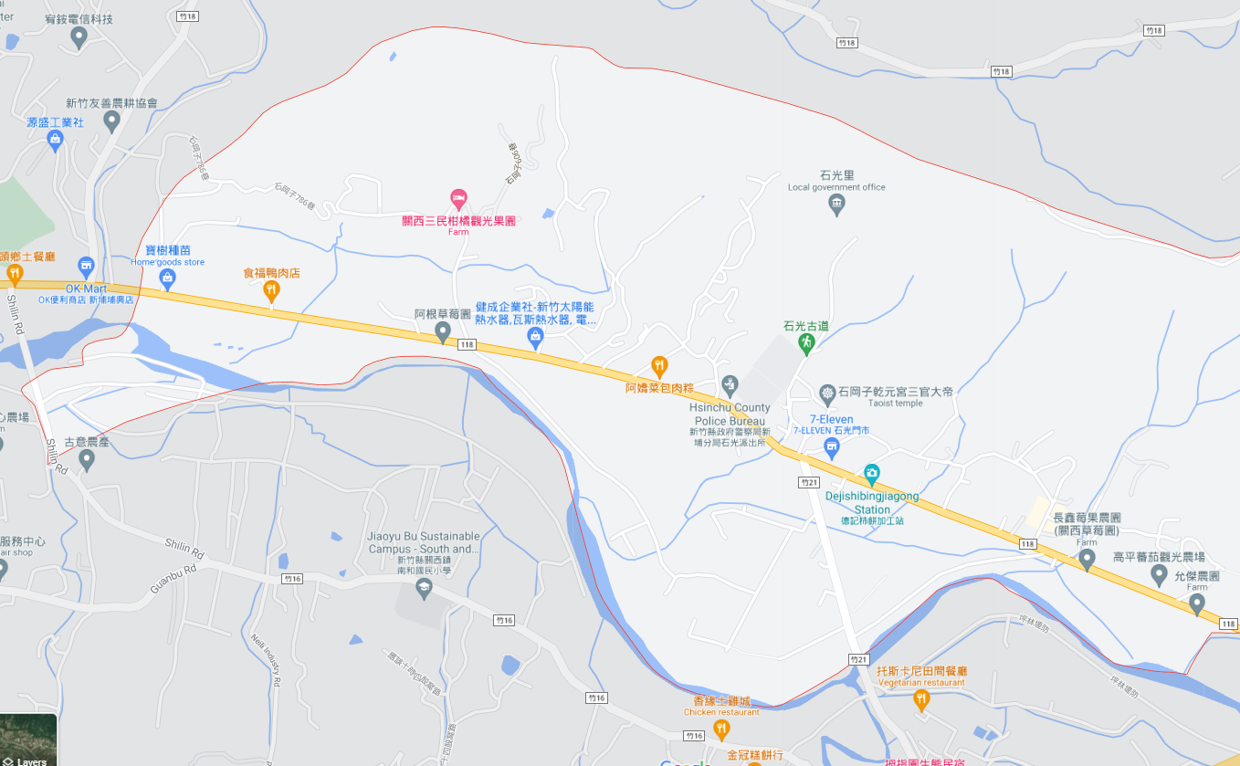
Hsinchu County Guanxi Township 【Shiguang Vil.】 Evacuation Map | NO.10004040015
Disaster Prevention Information
Administration Zone
POP : 1,952
Shiguang Vil.
Emergency Notification
Hsinchu County EOC Tel：03-5529222 Guanxi Township EOC Tel：03-5870110 Guanxi Fire Station Tel：03-5870110 Guanxi Police Station Tel：03-5872007
Emergency Contact
Village Chief ：Mr. Yen Tel：03-5868311 0910-160098
Shiguang Elementary School
Shiguang Police Station
Disaster Information Website
Debris Flow Disaster Prevention Information
Central Weather Bureau
Hsinchu Fire Bureau
Evacuation Shelter
Shiguang Elementary School Add：No. 386, Shigangzi. Tel： 03-5869311
LEGEND | Administrative Boundary | Labelling |  | Facility
 | Village Boundary Line | Evacuation Route |  | Indoor Evacuation Shelter | Medical Facility | Emergency Operation Center
 | Road | Tsunami Shelter | Earthquake Shelter | Outdoor Evacuation Shelter | Fire Department
 | County Road | Debris Flow Shelter | Flood Shelter | Helipad | Police Department
Hsinchu County Gov. Aug, 2023

Slide 16
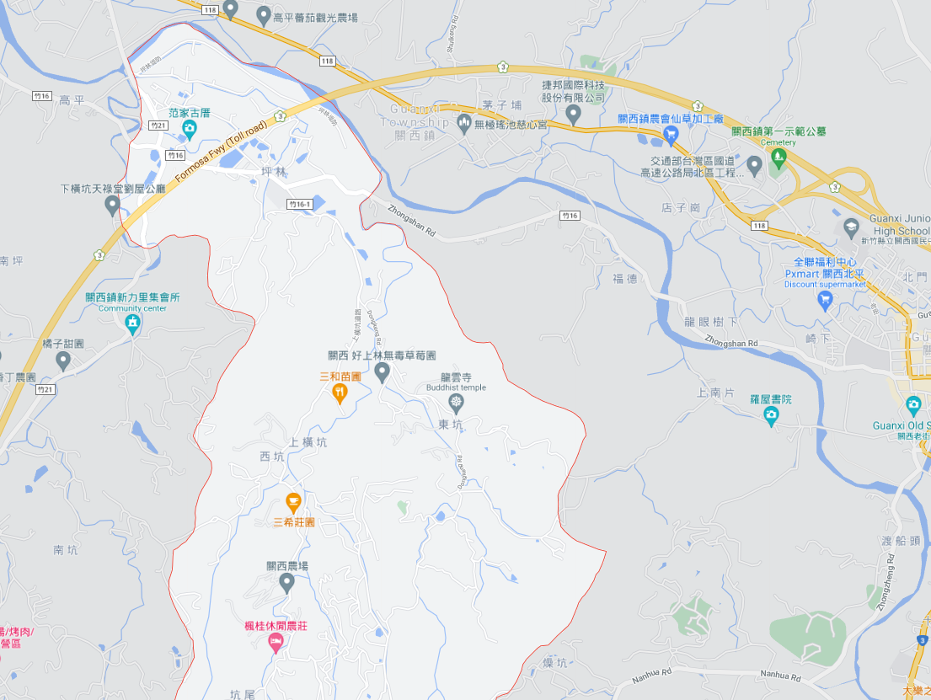
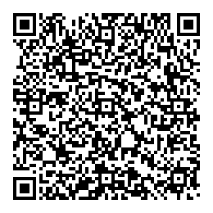
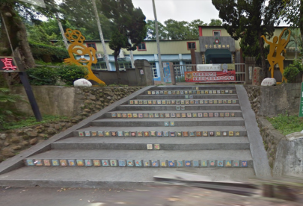
Hsinchu County Guanxi Township 【Shanglin Vil.】 Evacuation Map | NO.10004040016
Disaster Prevention Information
Administration Zone
POP : 868
Emergency Notification
Hsinchu County EOC Tel：03-5529222 Guanxi Township EOC Tel：03-5870110 Guanxi Fire Station Tel：03-5870110 Guanxi Police Station Tel：03-5872007
Pinglin Elementary School
Guanxi Fire Station
Emergency Contact
Village Chief ：Mr. Yang Tel：03-5868536 0933-973385
Guanxi Police Station
Disaster Information Website
Guanxi Township Public Health Center
Debris Flow Disaster Prevention Information
Guanxi Township Office
Central Weather Bureau
Hsinchu Fire Bureau
Evacuation Shelter
Pinglin Elementary School Add：No. 11, Pinglin. Tel： 03-5869310
Shanglin Vil.
LEGEND | Administrative Boundary | Labelling |  | Facility
 | Village Boundary Line | Evacuation Route |  | Indoor Evacuation Shelter | Medical Facility | Emergency Operation Center
 | Road | Tsunami Shelter | Earthquake Shelter | Outdoor Evacuation Shelter | Fire Department
 | County Road | Debris Flow Shelter | Flood Shelter | Helipad | Police Department
Hsinchu County Gov. Aug, 2023

Slide 17
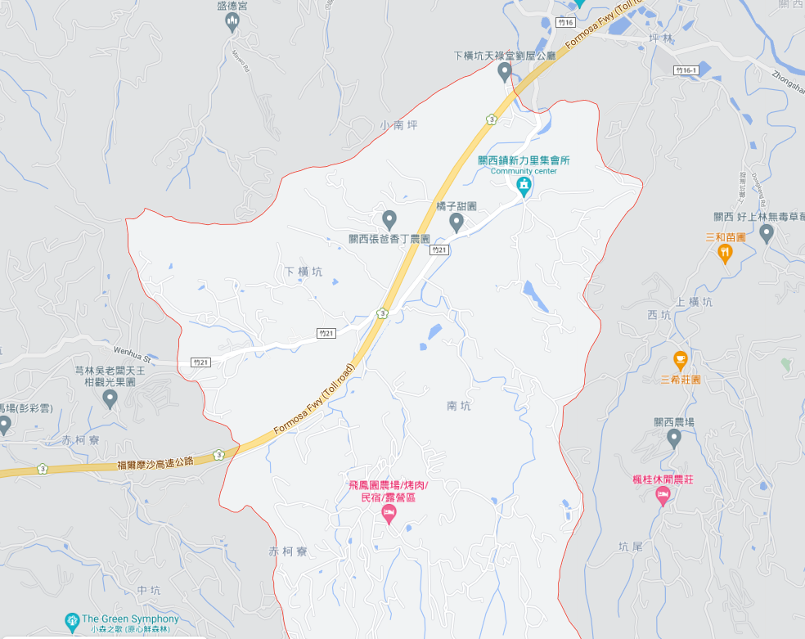
Hsinchu County Guanxi Township 【Xinli Vil.】 Evacuation Map | NO.10004040017
Disaster Prevention Information
Administration Zone
POP : 582
Pinglin Elementary School
Emergency Notification
Hsinchu County EOC Tel：03-5529222 Guanxi Township EOC Tel：03-5870110 Guanxi Fire Station Tel：03-5870110 Guanxi Police Station Tel：03-5872007
Emergency Contact
Village Chief ：Mr. Chang Tel：03-5860552 0937-125575
Xinli Vil.
Disaster Information Website
Debris Flow Disaster Prevention Information
Central Weather Bureau
Hsinchu Fire Bureau
Evacuation Shelter
Pinglin Elementary School Add：No. 11, Pinglin. Tel： 03-5869310
LEGEND | Administrative Boundary | Labelling |  | Facility
 | Village Boundary Line | Evacuation Route |  | Indoor Evacuation Shelter | Medical Facility | Emergency Operation Center
 | Road | Tsunami Shelter | Earthquake Shelter | Outdoor Evacuation Shelter | Fire Department
 | County Road | Debris Flow Shelter | Flood Shelter | Helipad | Police Department
Hsinchu County Gov. Aug, 2023

Slide 18
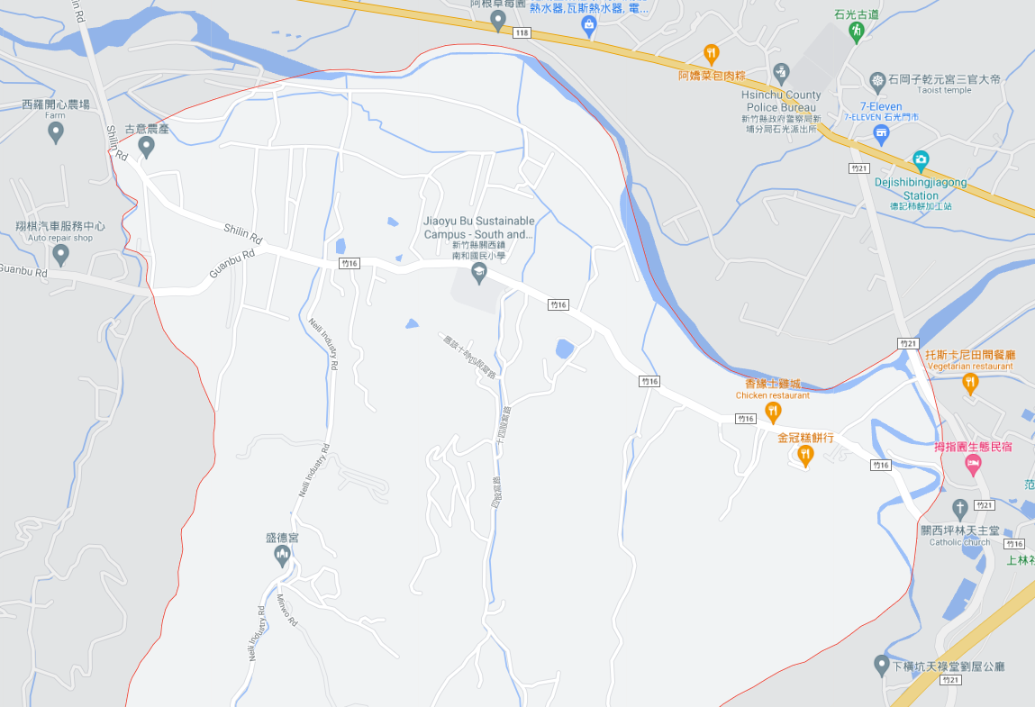
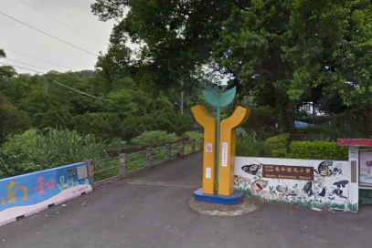
Hsinchu County Guanxi Township 【Nanhe Vil.】 Evacuation Map | NO.10004040018
Disaster Prevention Information
Administration Zone
POP : 891
Shiguang Police Station
Nanhe Vil.
Emergency Notification
Hsinchu County EOC Tel：03-5529222 Guanxi Township EOC Tel：03-5870110 Guanxi Fire Station Tel：03-5870110 Guanxi Police Station Tel：03-5872007
Nanhe Elementary School
Emergency Contact
Village Chief ：Mr. Chen Tel：03-5860338 0920-722206
Disaster Information Website
Debris Flow Disaster Prevention Information
Central Weather Bureau
Hsinchu Fire Bureau
Evacuation Shelter
Nanhe Elementary School Add：No. 69, Nanhe Vil. Tel： 03-5868952
LEGEND | Administrative Boundary | Labelling |  | Facility
 | Village Boundary Line | Evacuation Route |  | Indoor Evacuation Shelter | Medical Facility | Emergency Operation Center
 | Road | Tsunami Shelter | Earthquake Shelter | Outdoor Evacuation Shelter | Fire Department
 | County Road | Debris Flow Shelter | Flood Shelter | Helipad | Police Department
Hsinchu County Gov. Aug, 2023

Slide 19
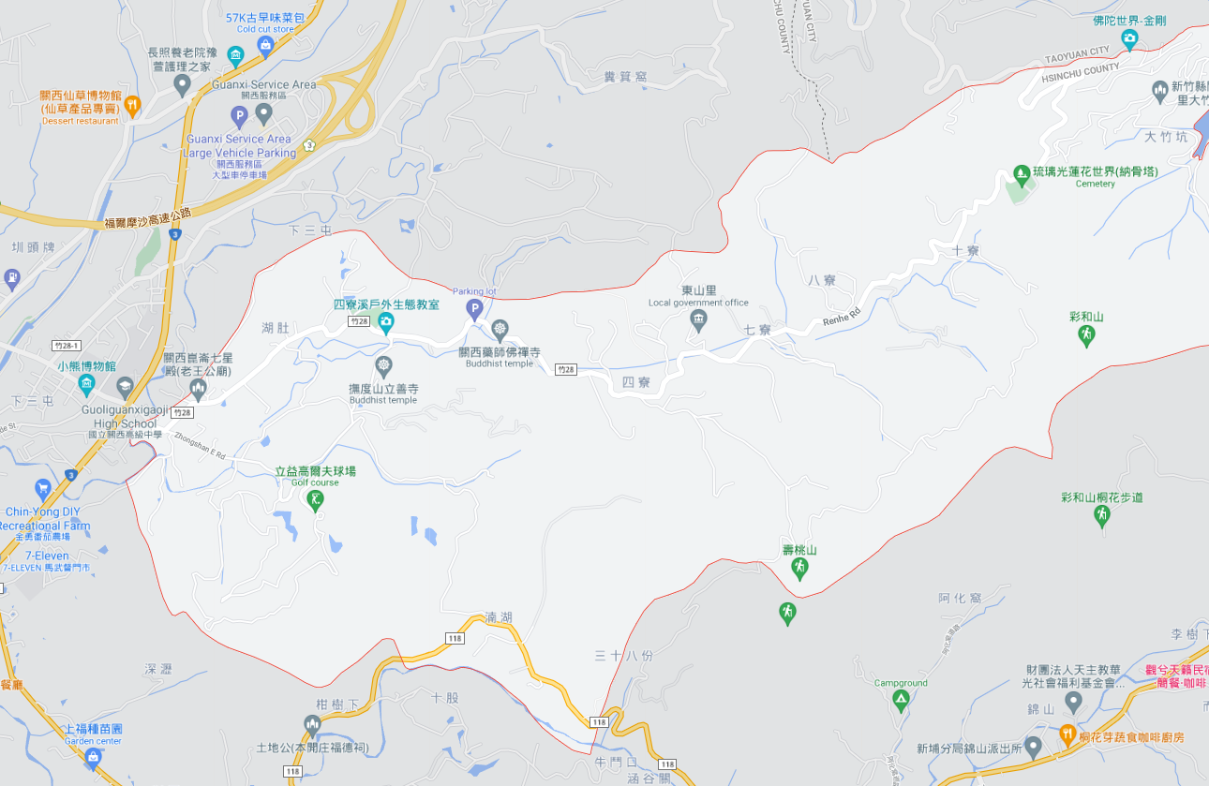
Hsinchu County Guanxi Township 【Dongshan Vil.】 Evacuation Map | NO.10004040019
Disaster Prevention Information
Administration Zone
POP : 905
Emergency Notification
Hsinchu County EOC Tel：03-5529222 Guanxi Township EOC Tel：03-5870110 Guanxi Fire Station Tel：03-5870110 Guanxi Police Station Tel：03-5872007
Dongshan Vil.
Dongan Police Station
Emergency Contact
Village Chief ：Mr. Wu Tel：03-5170394 0938-669465
Dong-an Elementary School
Guanxi Senior High School
Disaster Information Website
Debris Flow Disaster Prevention Information
Central Weather Bureau
Hsinchu Fire Bureau
Evacuation Shelter
Dong-an Elementary School Add：No. 40, Zhongshan E. Rd. Tel： 03-5872177
Guanxi Senior High School Add：No. 2, Zhongshan E. Rd. Tel： 03-5872049
LEGEND | Administrative Boundary | Labelling |  | Facility
 | Village Boundary Line | Evacuation Route |  | Indoor Evacuation Shelter | Medical Facility | Emergency Operation Center
 | Road | Tsunami Shelter | Earthquake Shelter | Outdoor Evacuation Shelter | Fire Department
 | County Road | Debris Flow Shelter | Flood Shelter | Helipad | Police Department
Hsinchu County Gov. Aug, 2023

Slide 20
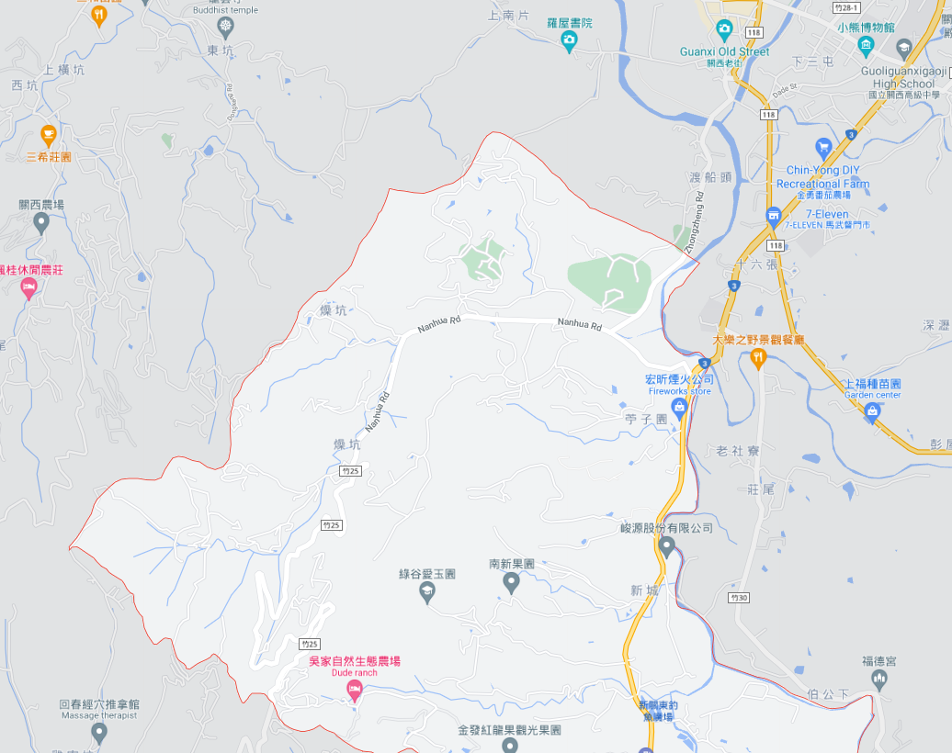
Hsinchu County Guanxi Township 【Nanxin Vil.】 Evacuation Map | NO.10004040020
Disaster Prevention Information
Dongan Police Station
Administration Zone
POP : 946
Dong-an Elementary School
Emergency Notification
Hsinchu County EOC Tel：03-5529222 Guanxi Township EOC Tel：03-5870110 Guanxi Fire Station Tel：03-5870110 Guanxi Police Station Tel：03-5872007
Emergency Contact
Village Chief ：Mr. Su Tel：03-5873852 0910-084604
Dongguang Elementary School
Disaster Information Website
Debris Flow Disaster Prevention Information
Central Weather Bureau
Hsinchu Fire Bureau
Nanxin Vil.
Evacuation Shelter
Dong-an Elementary School Add：No. 40, Zhongshan E. Rd. Tel： 03-5872177
Dongguang Elementary School Add：No. 190, Shiliuzhang. Tel： 03-5872243
LEGEND | Administrative Boundary | Labelling |  | Facility
 | Village Boundary Line | Evacuation Route |  | Indoor Evacuation Shelter | Medical Facility | Emergency Operation Center
 | Road | Tsunami Shelter | Earthquake Shelter | Outdoor Evacuation Shelter | Fire Department
 | County Road | Debris Flow Shelter | Flood Shelter | Helipad | Police Department
Hsinchu County Gov. Aug, 2023

Slide 21
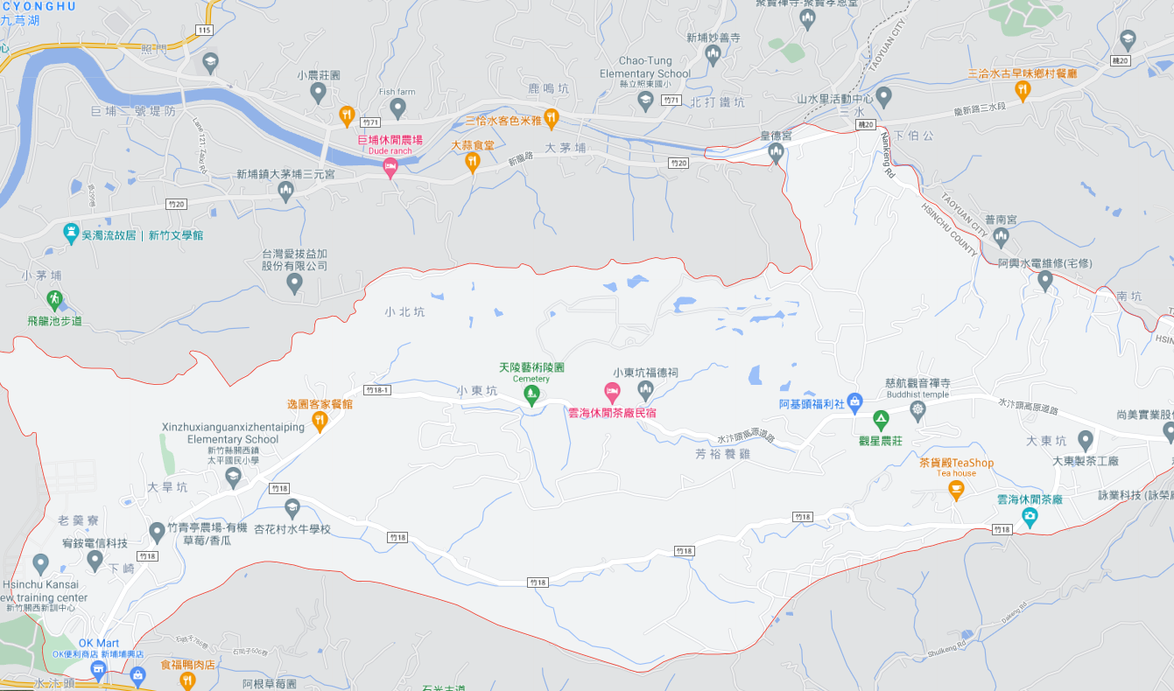
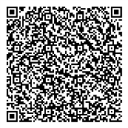
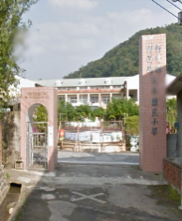
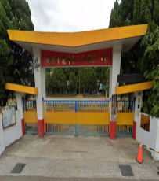
Hsinchu County Guanxi Township 【Dongping Vil.】 Evacuation Map | NO.10004040021
Disaster Prevention Information
Administration Zone
POP : 1,000
Sanhe Elementary School
Emergency Notification
Hsinchu County EOC Tel：03-5529222 Guanxi Township EOC Tel：03-5870110 Guanxi Fire Station Tel：03-5870110 Guanxi Police Station Tel：03-5872007
Dongping Vil.
Emergency Contact
Village Chief ：Mr. Teng Tel：03-5880338 0935-097522
Disaster Information Website
Debris Flow Disaster Prevention Information
Central Weather Bureau
Hsinchu Fire Bureau
Taiping Elementary School
Evacuation Shelter
Taiping Elementary School Add：No. 27, Dahankeng Tel： 03-5882634
Sanhe Elementary School Add：No. 39, Sanhe Vil. Tel： 03-4792154
LEGEND | Administrative Boundary | Labelling |  | Facility
 | Village Boundary Line | Evacuation Route |  | Indoor Evacuation Shelter | Medical Facility | Emergency Operation Center
 | Road | Tsunami Shelter | Earthquake Shelter | Outdoor Evacuation Shelter | Fire Department
 | County Road | Debris Flow Shelter | Flood Shelter | Helipad | Police Department
Hsinchu County Gov. Aug, 2023

